Slide 1

Analisa Struktur
BEBAN MERATA
Menghitung Bidang Momen, Lintang, dan Normal
Rizik Ricky Ardi
1822201043
Teknik Sipil

Slide 2
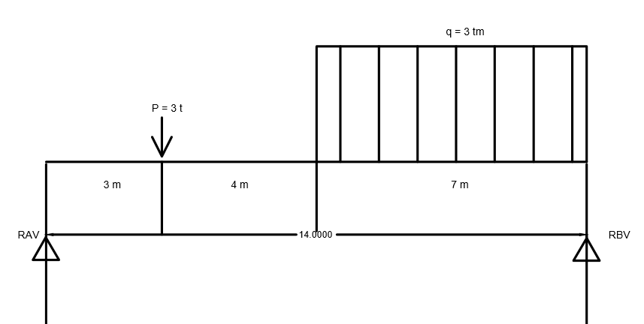
1
Diketahui
x | = | 3 | m |  |  |  | L1 | = | 3 | m
y | = | 4 | m |  |  |  | L2 | = | 4 | m
q | = | 3 | t/m |  |  |  | L3 | = | 7 | m
P | = | x | = | 3 | Ton
Ditanya :
1. Bidang Momen (M)
2. Bidang Lintang (D/L)
3. Bidang Normal (N)

Slide 3
REAKSI
ƩMB | = | 0
Rav | . | Ltotal | - | ( | q | . | L3 | ) | . | L3/2 | - | P | ( | L2+L3 | ) | = | 0
Rav | . | 14 | - | ( | 3 | . | 7 | ) | . | 3,5 | - | 3 | ( | 11 | ) | = | 0
14 | Rav | - | 73,5 | - | 33 | = | 0
14 | Rav | - | 106,5
 | Rav | = | 106,5
 |  |  | 14
 | Rav | = | 7,61 | Ton
ƩMA | = | 0
- | Rbv | . | Ltotal | + | ( | q | . | L3 | ) | ( | L3/2 | + | L2 | + | L1 | ) | + | P | . | L1 | = | 0
- | Rbv | . | 14 | + | ( | 3 | . | 7 | ) | ( | 3,5 | + | 4 | + | 3 | ) | + | 3 | . | 3 | = | 0
- | 14 | Rbv | + | 21 | . | 10,5 | + | 9 | = | 0
- | 14 | Rbv | + | 220,5 | + | 9 | = | 0
- | 14 | Rbv | + | 229,5 | = | 0
 |  | Rbv | = | 229,5
 |  |  |  | 14
 |  | Rbv | = | 16,39 | Ton
ƩV | = | 0
Rav | - | q | . | L3 | - | P | + | Rbv | = | 0
7,61 | - | 3 | . | 7 | - | 3 | + | 16,39 | = | 0
 |  | 7,61 | - | 21 | - | 3 | + | 16,39 | = | 0
 |  |  |  |  |  |  |  | 0 | = | 0

Slide 4
BIDANG MOMEN (M)
Interval = |  | 0 | < | X1 | < | L/2 | ( | 7 | )
Mxx1 - x1 |  | = | Rav | . | X1 | - | P | . | L2
 | X0 | = | 0 |  | Mx0 | = | Rav | . | X0 |  | X4 | = | 4 |  | Mx4 | = | Rav | . | X4
 |  |  |  |  |  | = | 7,61 | . | 0 |  |  |  |  |  |  | = | 7,607 | . | 4
 |  |  |  |  |  | = | 0 | Tm |  |  |  |  |  |  |  | = | 30,43 | Tm
 | X1 | = | 1 |  | Mx1 | = | Rav | . | X1 |  | X5 | = | 5 |  | Mx5 | = | Rav | . | X5
 |  |  |  |  |  | = | 7,61 | . | 1 |  |  |  |  |  |  | = | 7,607 | . | 5
 |  |  |  |  |  | = | 7,61 | Tm |  |  |  |  |  |  |  | = | 38,04 | Tm
 | X2 | = | 2 |  | Mx2 | = | Rav | . | X2 |  | X6 | = | 6 |  | Mx6 | = | Rav | . | X6
 |  |  |  |  |  | = | 7,61 | . | 2 |  |  |  |  |  |  | = | 7,607 | . | 6
 |  |  |  |  |  | = | 15,2 | Tm |  |  |  |  |  |  |  | = | 45,64 | Tm
 | X3 | = | 3 |  | Mx3 | = | Rav | . | X3 |  | X7 | = | 7 |  | Mx7 | = | Rav | . | X7
 |  |  |  |  |  | = | 7,61 | . | 3 |  |  |  |  |  |  | = | 7,607 | . | 7
 |  |  |  |  |  | = | 22,8 | Tm |  |  |  |  |  |  |  | = | 53,25 | Tm

Slide 5
Interval = |  | 0 | < | X2 | < | L
Mxx2 - x2 |  | = | Rav | . | (L1 | + | L2 | + | L3/2) | - | P | . | ( | L2+L3 | ) | - | ( | q | . | L3/2 | ) | . | L3/2
 |  | = | 7,61 | . | ( | 10,5 | ) | - | 3 | . | 11 | - | ( | 10,5 | ) | . | 3,5 |  |  |  |  |  | 2
 |  | = | 79,9 | - | 33 | - | ( | 10,5 | . | 1,75 | ) |  |  |  |  |  | 2
 |  | = | 46,9 | - | 18,38
 |  | = | 28,5 | Tm
Mxx2 - x2 |  | = | Rav | . | Ltotal | - | P | . | ( | L2+L3 | ) | - | ( | q | . | L3 | ) | . | L3/2
 |  | = | 7,61 | . | 14 | - | 3 | . | 11 | - | ( | 3 | . | 7 | ) | . | 3,5
 |  | = | 107 | - | 33 | - | ( | 21 | ) | . | 3,5
 |  | = | 73,5 | - | 73,5
 |  | = | 0 | Tm

Slide 6
BIDANG LINTANG (D/L)
Interval = |  | 0 | < | X1 | < | L/2
Dx | = | 7
Dxx | = | Rav
 | = | 7,61 | ton
Dxx | = | Rav | - | P
 | = | 7,61 | - | 3
 | = | 4,61 | ton
Interval = |  | 0 | < | X2 | < | L
Dxx | = | Rav | . | Ltotal | - | P | . | ( | L2 | + | L3/2 | ) | - | ( | q | . | L3/2 | ) | . | L3/2
 |  |  |  |  |  |  |  |  |  |  |  |  |  |  |  |  |  |  |  | 2
Dxx | = | Rav | - | P | - | ( | q | . | L3/2 | )
 | = | 7,61 | - | 3 | - | ( | 3 | . | 3,5 | )
 | = | 4,61 | - | 10,5
 | = | -5,9 | ton
Dxx | = | Rav | . | Ltotal | - | P | . | ( | L2+L3 | ) | - | ( | q | . | L3 | ) | . | L3/2
Dxx | = | Rav | - | P | - | ( | q | . | L3 | )
 | = | 7,61 | - | 3 | - | ( | 3 | . | 7 | )
 | = | 4,61 | - | 21
 | = | -16,4 | ton

Slide 7
BIDANG NORMAL (N)
ƩH | = | 0
Rah | = | 0

Slide 8
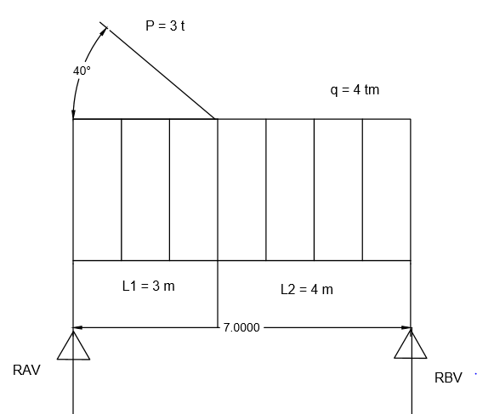
2
Diketahui
x | = | 3 | m |  |  |  | L1 | = | 3 | m
y | = | 4 | m |  |  |  | L2 | = | 4 | m
q | = | 4 | t/m
P | = | x | = | 3 | Ton
Ditanya :
1. Bidang Momen (M)
2. Bidang Lintang (D/L)
3. Bidang Normal (N)

Slide 9
REAKSI
ƩMB | = | 0
Rav | . | Ltotal | - | ( | q | . | L | ) | . | L/2 | - | P | . | sin | 40 | . | L2 | = | 0
Rav | . | 7 | - | ( | 4 | . | 7 | ) | . | 3,5 | - | 3 | . | 0,64 | . | 4 | = | 0
7 | Rav | - | 98 | - | 7,71 | = | 0
7 | Rav | - | 105,7
 | Rav | = | 105,7
 |  |  | 7
 | Rav | = | 15,1 | Ton
ƩMA | = | 0
- | Rbv | . | Ltotal | + | ( | q | . | L | ) | . | L/2 | + | P | . | sin | 40 | . | L1 | = | 0
- | Rbv | . | 7 | + | ( | 4 | . | 7 | ) | . | 3,5 | + | 3 | . | 0,64 | . | 3 | = | 0
- | 7 | Rbv | + | 98 | + | 5,79 | = | 0
- | 7 | Rbv | + | 104 | = | 0
 |  | Rbv | = | 104
 |  |  |  | 7
 |  | Rbv | = | 14,8 | Ton
ƩV | = | 0
Rav | - | q | . | L | - | P | . | sin | 40 | + | Rbv | = | 0
15,1 | - | 4 | . | 7 | - | 3 | . | 0,64 | + | 14,8 | = | 0
 |  |  |  | 15,1 | - | 28 | - | 1,93 | + | 14,8 | = | 0
 |  |  |  |  |  |  |  | 0 | = | 0

Slide 10
BIDANG MOMEN (M)
Interval = |  | 0 | < | X1 | < | L/2 | ( | 3,5 | )
Mxx1 - x1 |  | = | Rav | . | L/2 | - | ( | q | . | L/2 | ) | ( | 3,5/2 | )
 | X0 | = | 0 |  | Mx0 | = | Rav | . | X0
 |  |  |  |  |  | = | 15,1 | . | 0
 |  |  |  |  |  | = | 0 | Tm
 | X1 | = | 1 |  | Mx1 | = | Rav | . | X1
 |  |  |  |  |  | = | 15,1 | . | 1
 |  |  |  |  |  | = | 15,1 | Tm
 | X3.5 | = | 3,5 |  | Mx2 | = | Rav | . | L/2 | - | ( | q | . | L/2 | ) | ( | 3,5/2 | )
 |  |  |  |  |  | = | 15,1 | . | 3,5 | - | ( | 4 | . | 3,5 | ) | ( | 1,75 | )
 |  |  |  |  |  | = | 52,9 | - | ( | 14 | ) | ( | 1,75 | )
 |  |  |  |  |  | = | 52,9 | - | 24,5
 |  |  |  |  |  | = | 28,4 | Tm

Slide 11
Interval |  | = | 0 | < | X2 | < | L
Mxx2 - x2 |  | = | Rav | . | L | - | P | . | sin | 40 | . | L2 | - | ( | q | . | L | ) | . | L/2
Mx3 |  | = | Rav | . | L | - | P | . | sin | 40 | . | L2 | - | ( | q | . | L | ) | . | L/2
 |  | = | 15,1 | . | 3 | - | 3 | . | 0,64 | . | 4 | - | ( | 4 | . | 3 | ) | . | 1,5
 |  | = | 45,3 | - | 7,713 | - | 18
 |  | = | 19,6
 |  | = | 19,6 | Tm
Mxx2 - x2 |  | = | Rav | . | L | - | P | . | sin | 40 | . | L2 | - | ( | q | . | L | ) | . | L/2
 |  | = | 15,1 | . | 7 | - | 3 | . | 0,64 | . | 4 | - | ( | 4 | . | 7 | ) | . | 3,5
 |  | = | 106 | - | 7,713 | - | 98
 |  | = | 0 | Tm

Slide 12
BIDANG LINTANG (D/L)
Interval = |  | 0 | < | X1 | < | L/2
X0 | = | 0 |  | Dx0 | = | Rav
 |  |  |  |  | = | 15,1
 |  |  |  |  | = | 15,1 | ton
X1 | = | 1 |  | Dx1 | = | Rav | . | X1
 |  |  |  |  | = | 15,1 | . | 1
 |  |  |  |  | = | 15,1 | ton
X3.5 | = | 3,5 |  | Dx3.5 | = | Rav | - | ( | q | . | L/2 | )
 |  |  |  |  | = | 15,1 | - | ( | 4 | . | 3,5 | )
 |  |  |  |  | = | 15,1 | - | 14
 |  |  |  |  | = | 1,1 | ton
Interval = |  | 0 | < | X2 | < | L
X3 | = | 3 |  | Dx3 | = | Rav | - | P | sin | 40 | - | ( | q | . | 3 | )
 |  |  |  |  | = | 15,1 | - | 3 | . | 0,64 | - | ( | 4 | . | 3 | )
 |  |  |  |  | = | 15,1 | - | 1,93 | - | 12 |  | .
 |  |  |  |  | = | 1,17 | Ton
X7 | = | 7 |  | Dx7 | = | Rav | - | P | sin | 40 | - | ( | q | . | 7 | )
 |  |  |  |  | = | 15,1 | - | 3 | . | 0,64 | - | ( | 4 | . | 7 | )
 |  |  |  |  | = | 15,1 | - | 1,93 | - | 28 |  | .
 |  |  |  |  | = | -14,8 | Ton

Slide 13
BIDANG NORMAL (N)
ƩH | = | 0
Rah | = | 0

Slide 14
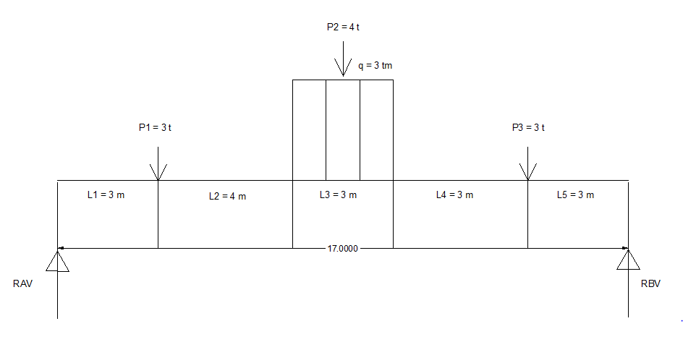
3
Diketahui
x | = | 3 | m |  |  |  | L1 | = | 3 | m
y | = | 4 | m |  |  |  | L2 | = | 4 | m
P1 | = | x | = | 3 | Ton |  | L3 | = | 3 | m
P2 | = | y | = | 4 | Ton |  | L4 | = | 4 | m
P3 | = | x | = | 3 | Ton |  | L5 | = | 3 | m
 |  |  |  |  |  |  | q | = | 3 | t/m
Ditanya :
1. Bidang Momen (M)
2. Bidang Lintang (D/L)
3. Bidang Normal (N)

Slide 15
REAKSI
ƩMB | = | 0
Rav | . | Ltotal | - | P1 | ( | L2+L3+L4+L5 |  |  | ) | - | P2 | ( | L3/2+L4+L5 |  |  | ) | - | ( | q | . | L3 | ) | ( | L3/2+L4+L5 |  |  |  |  | ) |  | - | P3 | . | L5 | = | 0
Rav | . | 17 | - | 3 | ( | 14 | ) | - | 4 | ( | 8,5 | ) | - | ( | 3 | . | 3 | ) | ( | 8,5 | ) | - | 3 | . |  |  | 3 | = | 0
17 | Rav | - | 42 | - | 34 | - | 76,5 | - | 9 | = | 0
17 | Rav | - | 161,5
 | Rav | = | 161,5
 |  |  | 17
 | Rav | = | 9,5 | Ton
ƩMA | = | 0
- | Rbv | . | Ltotal | + | P3 | ( | L4+L3+L2+L1 |  |  | ) | + | ( | q | . | L3 | ) | ( | L3/2+L2+L1 |  |  | ) | + | P2 | ( |  |  | L3/2+L2+L1 |  |  |  | ) | + | P1 | . | L1 | = | 0
- | Rbv | . | 17 | + | 3 | ( | 14 | ) | + | ( | 3 | . | 3 | ) | ( | 8,5 | ) | + | 4 | ( | 8,5 | ) | + | 3 |  |  | . | 3 |  | = | 0
- | 17 | Rbv | + | 42 | + | 76,5 | + | 34 | + | 9 | = | 0
- | 17 | Rbv | + | 161,5 | = | 0
- | 17 | Rbv | = | 161,5 | = | 0
 |  |  |  | 17
 |  | Rbv | = | 9,5 | Ton
ƩV | = | 0
Rav | - | q | . | L3 | - | Ptotal | + | Rbv | = | 0
9,5 | - | 3 | . | 3 | - | 10 | + | 9,5 | = | 0
 |  | 9,5 | - | 9 | - | 10 | + | 9,5 | = | 0
 |  |  |  |  |  |  |  | 0 | = | 0

Slide 16
BIDANG MOMEN (M)
Interval = |  | 0 | < | X1 | < | L/2 | ( | 8,5 | )
X0 | = | 0 |  | Mx0 | = | Rav | . | X0
 |  |  |  |  | = | 9,5 | . | 0
 |  |  |  |  | = | 0 | Tm
X8.5 | = | 8,5 |  | Mx8.5 | = | Rav | . | L/2 | - | P1 | . | L2 | + | L3/2 | - | ( | q | . | L3/2 | ) | . | L3/2
 |  |  |  |  |  |  |  |  |  |  |  |  |  |  |  |  |  |  |  |  |  | 2
 |  |  |  |  | = | 9,5 | . | 8,5 | - | 3 | . | 4 | + | 1,5 | - | ( | 3 | . | 1,5 | ) | . | 0,75
 |  |  |  |  | = | 80,75 | - | 12 | + | 1,5 | - | ( | 4,5 | ) | . | 0,75
 |  |  |  |  | = | 70,25 | - | 3,375
 |  |  |  |  | = | 66,88 | Tm
Interval |  | = | 0 | < | X2 | < | L
Xtotal | = | 17 |  | Mx17 | = | Rav | . | Ltotal | - | P1 | ( | L2+L3+L4+L5 |  |  | ) | - | P2 | ( | L3/2+L4+L5 |  |  | ) | - | P3 | . | L5 | - | ( | q | . | L3 | ) | ( | L3/2+L4+L5 |  |  | )
 |  |  |  |  | = | 9,5 | . | 17 | - | 3 | ( | 14 | ) | - | 4 | ( | 8,5 | ) | - | 3 | . | 3 | - | ( | 3 | . | 3 | ) | ( | 8,5 | )
 |  |  |  |  | = | 161,5 | - | 42 | - | 34 | - | 9 | - | 77
 |  |  |  |  | = | 0

Slide 17
BIDANG LINTANG (D/L)
Interval = |  | 0 | < | X1 | < | L/2
Dx | = | 8,5
Dxx | = | Rav
 | = | 9,5 | ton
Dxx | = | Rav | - | ( | P1+P2+P3 |  | ) | - | ( | q | . | L3/2 | )
 | = | 9,5 | - | 10 | - | ( | 3 | . | 2 | )
 | = | 9,5 | - | 10 | - | 4,5
 | = | -5 | ton
Interval = |  | 0 | < | X2 | < | L
Dx | = | 17
Dxx | = | Rav | - | ( | P1+P2+P3 |  | ) | - | ( | q | . | L3 | )
 | = | 9,5 | - | 10 | - | ( | 3 | . | 3 | )
 | = | 9,5 | - | 10 | - | 9
 | = | -9,5 | ton

Slide 18
BIDANG NORMAL (N)
ƩH | = | 0
Rah | = | 0

